Slide 1

Predicting A Student's Adaptability Level in Online Education
SHUBHAANGI VERMA (RA1911026030026)
TANISHK ARORA (RA1911026030019)
AYUSH RAWAT (RA1911026030045)
RISHIKA SHARMA (RA1911026030046)
GUIDE NAME :- Dr. ANAND PANDEY
CSE – A
MAY 2023

Slide 2

Motivation
Increasing importance of online education since Covid-19.
Factors affecting adaptability level in online education.
Different students faced different difficulties.
Predicting the adaptability level beforehand helps improve it to get an optimal level.

Slide 3

Introduction
The Covid-19 pandemic has forced a massive shift towards online learning, leading to an increased emphasis on the adaptability of students to this new mode of education. The importance of understanding the factors that impact a student's adaptability to online learning cannot be overstated. With this in mind, our team has set out to develop a classifier that can analyze various parameters related to a student's personal and academic background, as well as their learning habits, and determine how these factors relate to their level of adaptability in online learning.

Slide 4

LITERATURE REVIEW
Impact of technology on virtual learning system. Multiple research papers published to study different factors. Researchers studied the improvement of online education model. Comparison between offline and online education system. Similar trends in on-campus vs off-campus performances. Difficulties faced in online education systems Rural areas vs Urban Areas : The former faced more challenges Lots of barriers : technological, communication, financial, etc. Impact of pandemic on the global education system. According to one research, better learning in online education systems.

Slide 5
EXISTING PLAN
One of the major problems that students face with online education is the lack of face to-face interaction with their teachers and peers. In traditional in-person learning, students can interact with their teachers and classmates in real-time, ask questions, and get feedback instantly. However, in online learning, students are limited to virtual interactions, which can be less engaging and less effective than face-to-face interactions. Moreover, students who are not comfortable with technology may struggle to participate in online classes and communicate with their teachers and peers.
Another issue that students face with online education is the lack of structure and routine. In traditional in-person learning, students have a set schedule and routine that helps them stay on track and manage their time effectively.
However, with online learning, students often have to create their own schedule and manage their time independently, which can be challenging for some students. Students who struggle with self-discipline and time management may find it difficult to stay motivated and focused in an online learning environment.

Slide 6
PROPOSED SOLUTION
There are many different machine learning models that can be used to predict student adaptability in online learning. The choice of model depends on the specific problem, data, and available resources. We are going to use these machine learning models for predicting student adaptability in online learning: Decision Tree: This model is often used for classification problems and can be used to predict whether a student is likely to drop out of an online course or succeed. Decision trees can be easy to interpret and can handle categorical and continuous data. Random Forest: This model is an extension of decision trees and can be used for both classification and regression problems. Random forests can handle missing data, noisy data, and can capture nonlinear relationships.

Slide 7
Support Vector Machine (SVM): This model is a powerful classifier that can handle high- dimensional data and non-linear relationships. SVM can be used to predict student success or engagement in online courses. Artificial Neural Networks: This model is highly flexible and can be used for both classification and regression problems. Neural networks can capture complex relationships between input features and output variables and can handle large datasets. K Nearest Neighbours: K-nearest neighbors (KNN) is a non-parametric algorithm used for both classification and regression tasks in machine learning. It is a simple and intuitive algorithm that works by finding the "nearest" data points to a given input based on some distance metric. Once the nearest neighbors are identified, the algorithm makes a prediction based on the class or value of those neighbors.

Slide 8
Gaussian Naive Bayes: Gaussian Naive Bayes is a probabilistic algorithm used for classification tasks in machine learning. It is a simple and efficient algorithm that is based on the Bayes theorem and assumes that the features are conditionally independent given the class variable. Logistic Regression: This model is often used for binary classification problems and can be used to predict whether a student will drop out of an online course or not. Logistic regression is simple to implement, can handle continuous and categorical data, and provides interpretable coefficients.

Slide 9
METHODOLOGIES
Data preprocessing is a procedure of getting ready the raw information and making it suitable fora device gaining knowledge. It's the first and important step even as creating a Machine Learning Model. When creating a machine learning model, it is not continually a case that we encounter the smooth and formatted records. And while doing any operation with data, it's miles obligatory to easy it and put in a formatted way. So for this, we use data preprocessing project. Real-world data is typically complex and may contain various types of noise, missing values, and formatting inconsistencies that render it unsuitable for use in machine learning models. Therefore, it is essential to perform data preprocessing tasks to clean, transform, and prepare the data for analysis. By doing so, the accuracy and efficiency of machine learning models can be significantly improved, leading to more reliable results and better decision-making.

Slide 10
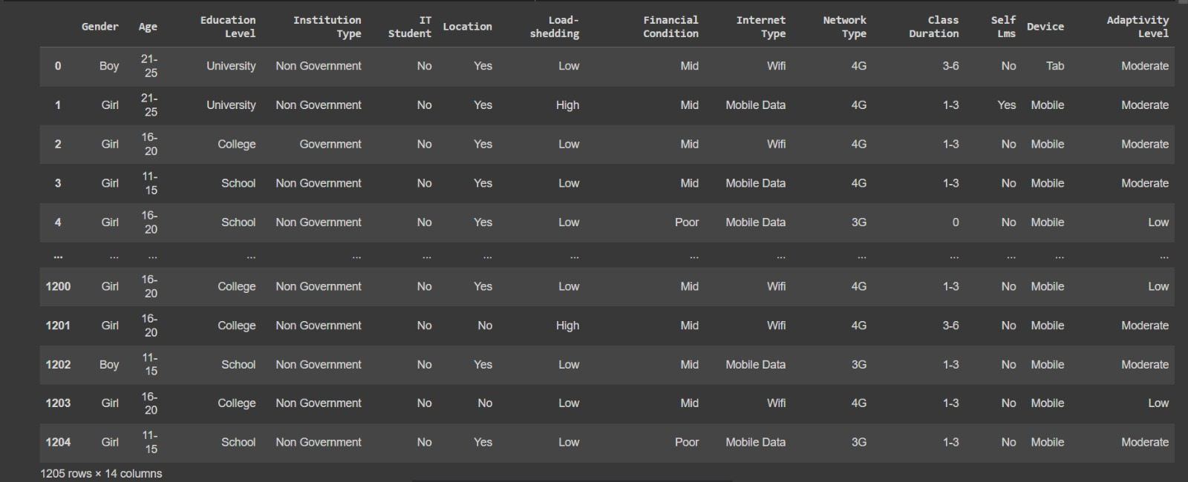
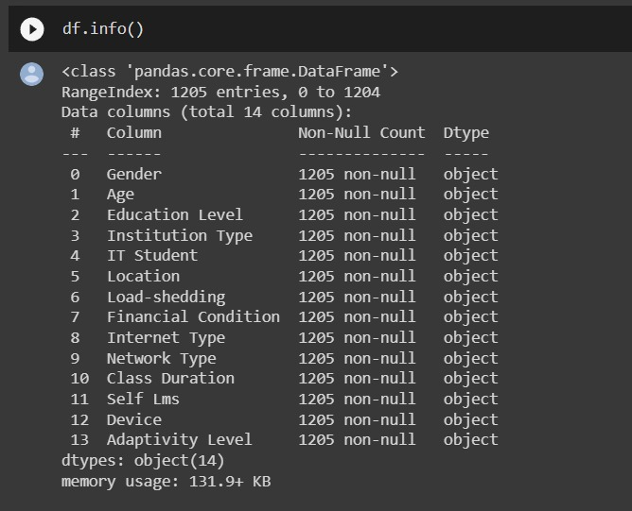
title
DATASET DESCRIPTION
The dataset Contains categorical data.
Some of the features contain binary values for eg. Yes/no, boy/girl.
As our data is categorical, no outlier is observed.
Initial Dataset
Data Exploration

Slide 11
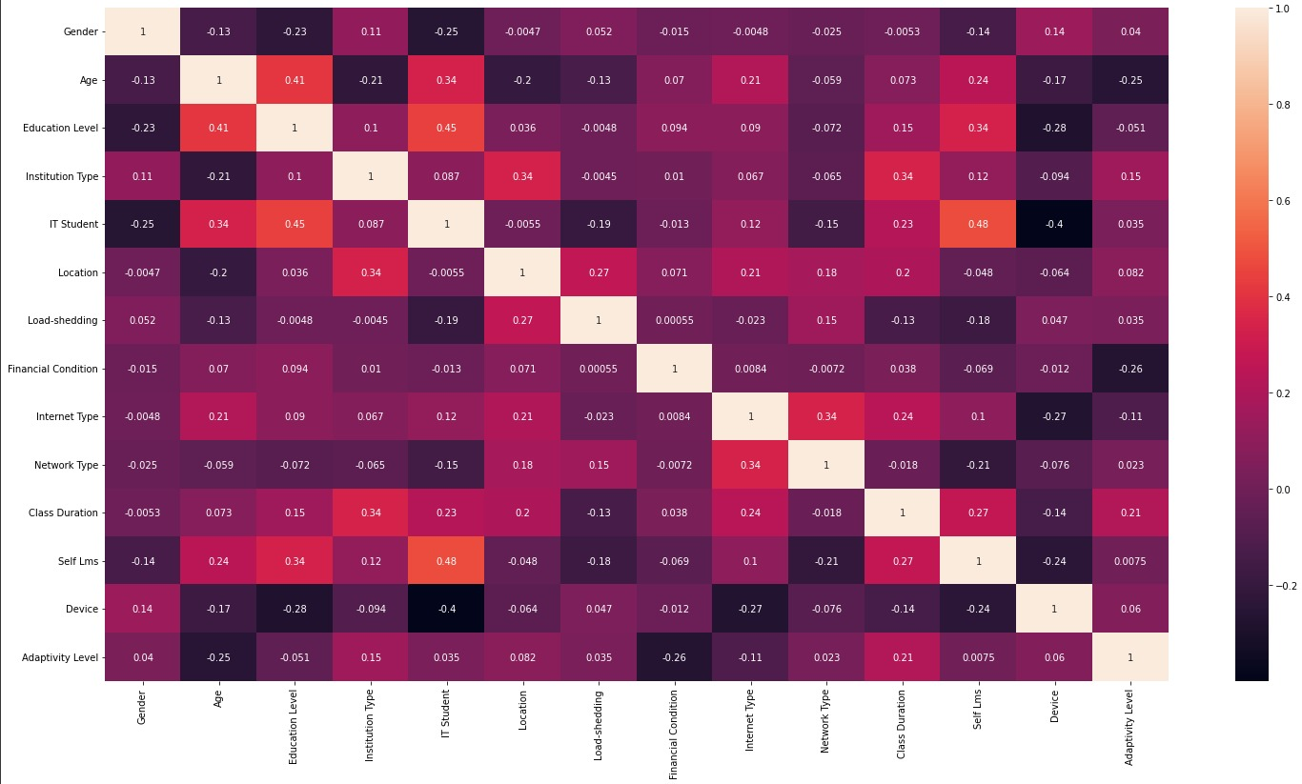
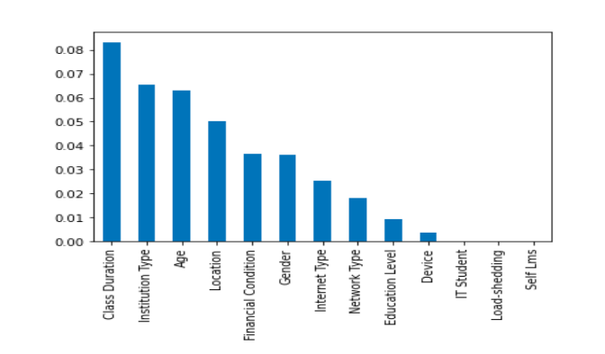
DATASET PREPROCESSING
No Null Values observed. String values in the dataset have been scaled to integers. Features like "Load Shedding" and "Self LMS" have very low correlation w.r.t target variable and low information gain hence are dropped while selecting features to improve model performance.

Slide 12
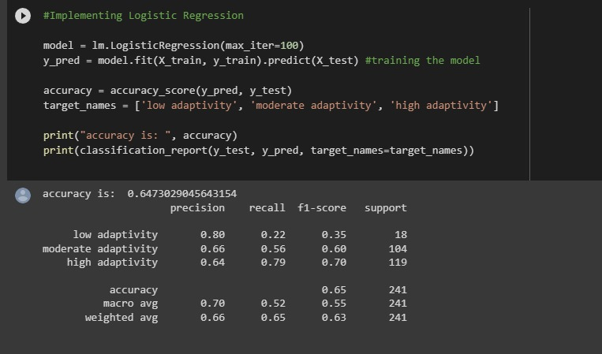
MODEL TRAINING 1) LOGISTIC REGRESSION

Slide 13
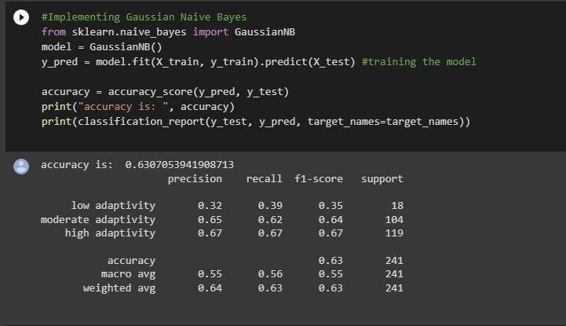
2) Gaussian Naive Bayes

Slide 14
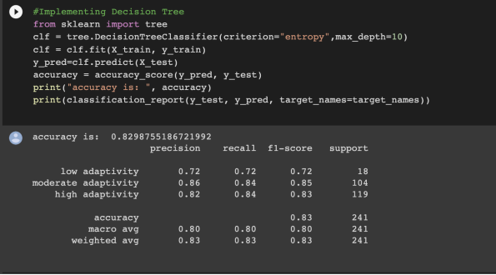
3) Decision Trees

Slide 15
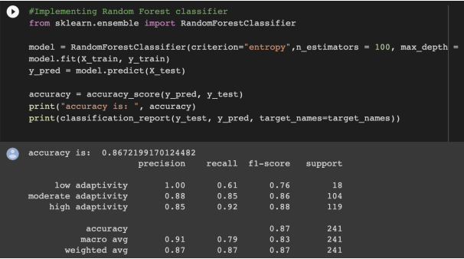
4) Random Forest

Slide 16
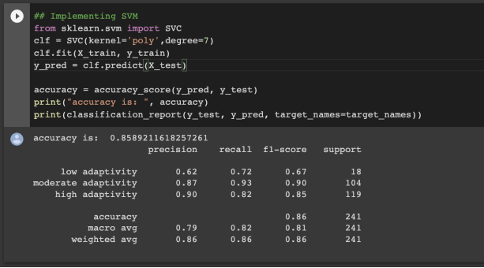
5) Support Vector Machine

Slide 17
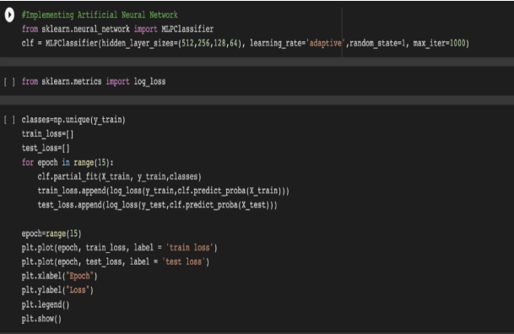
6) Multi -Layer Perceptron Training

Slide 18
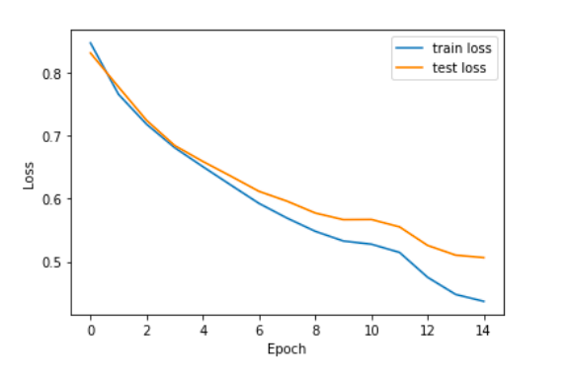
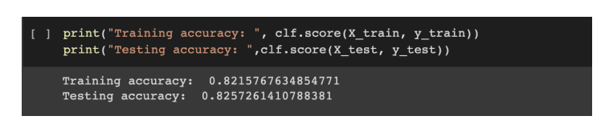
Loss plot for MLP
MLP
Loss Plot for MLP
Accuracy for MLP

Slide 19
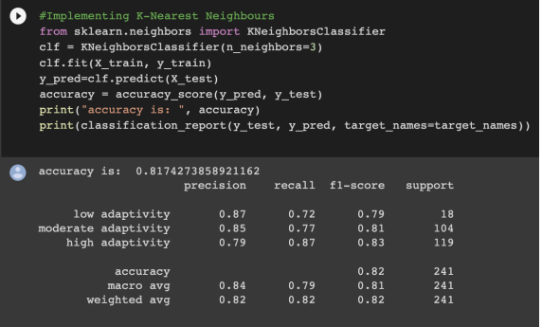
K-Nearest Neighbors

Slide 20
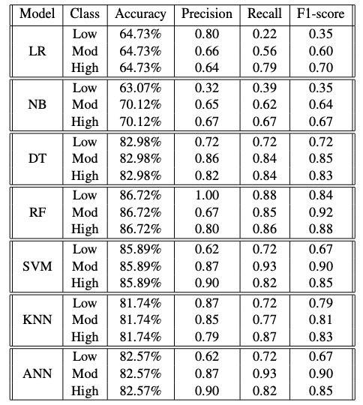
By training the above models on the given dataset, we can say that Random Forests give the best performance amongst all the classifiers used for prediction as it has more accuracy, precision, recall, F1-score than other classifiers. Below is a table which can be used for comparison between different models.
RESULTS

Slide 21
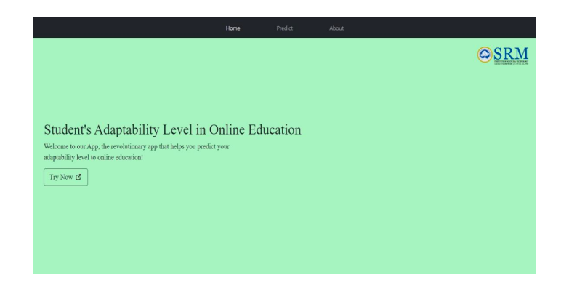
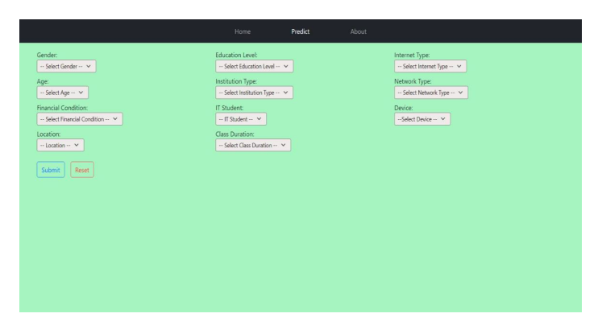
GUI OUTPUT
We have created GUI with the help of ReactJs in the frontend and Flask in the backend using libraries such as Numpy, Picle, Flask, Flask_cors, React_router-dom, Bootstrap etc. After providing proper inputs in gender, age, education level etc. sections we click on “Submit" button to predict.
Home page in GUI Interface
Prediction Interface

Slide 22
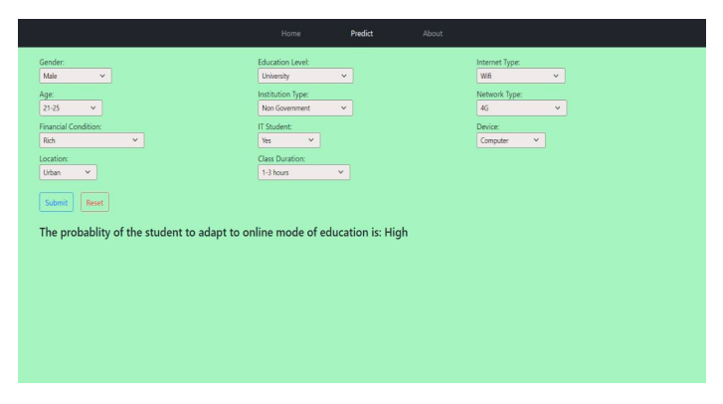
1) A test case where the model predicts high level of adaptability

Slide 23
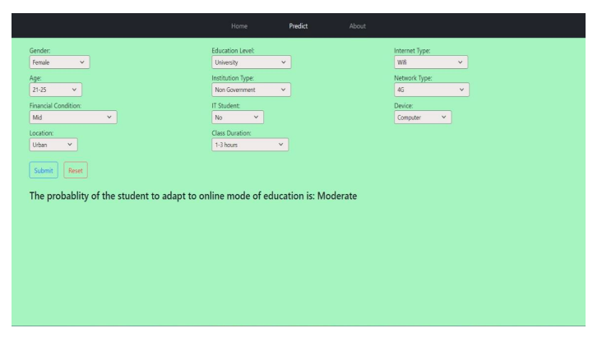
2) A test case where the model predicts moderate level of adaptability

Slide 24
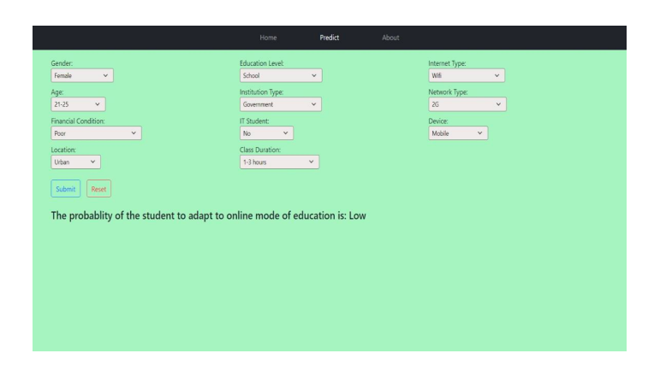
3) A test case where the model predicts low level of adaptability

Slide 25
Tried to forecast the student's adaptability level using ML models.
CONCLUSION & FUTURE SCOPE
Tried to forecast the student's adaptability level using ML models. Used classifiers such as Logistic Regression, Gaussian NB, Decision Trees, Random Forest, Support Vector Machine, ANN and KNN. Since the data is categorical so decision trees work well and hence random forest(ensemble learning of DTs) works the best for the given dataset. Work done would beneficial for the educational decision makers to improve the quality of education.

Slide 26
1) Dataset: https://www.kaggle.com/datasets/mdmahmudulhasansuzan/studentsadaptability-level-in-online-education 2) https://ccrc.tc.columbia.edu/media/k2/attachments/adaptability-to-onlinelearning.pdf 3) https://eric.ed.gov/?id=EJ1175336 4) https://ijonse.net/index.php/ijonse/article/view/49 5) https://www.researchgate.net/publication/349601508_Barriers_to_Online_Lea rning_in_the_Time_of_COVID19_A_National_Survey_of_Medical_Students_in_the_Philippines 6) https://www.frontiersin.org/articles/10.3389/fpsyg.2021.637776/full 7) https://educationaltechnologyjournal.springeropen.com/articles/10.1186/s4123 9-021-00252-3
REFERENCES

